Slide 1
Production Concepts
Steward Savage
Carnegie Vanguard HS
ssavage1@houstonisd.org

Slide 2
WHAT IS PRODUCTION CONCEPT?
The production concept is the unifying creative vision for the design elements of a stage play. It allows such diverse elements as costumes, set design, and lighting to mutually support a creative goal.
So how is a production concept itself conceptualized?
It all begins with interpretation.

Slide 3
INTERPRETATION
Interpretation is the act of drawing out and communicating underlying meaning from a creative work.
Through careful and comprehensive interpretation, central themes and values can be identified within a play script and production elements designed accordingly.
In all instances, the production concept considers context and atmosphere and applies them to elements of composition.

Slide 4
CONTEXT AND ATMOSPHERE
Context refers to environment, situation, and circumstances. (For a play script, this might include everything from historical era and geographical setting, or even season of the year, to character circumstances like class, ethnicity, subculture, generation, or family unit. )
The atmosphere describes the tone, mood, and general feeling within the context.
I.e. Macbeth

Slide 5
COMPOSITION
Much like a painter composes through cohesive integration of line, color, light/shadow, and texture, a fully developed production concept will consider such fundamentals of composition in its overall design scheme.

Slide 6
ELEMENTS AND PRINCIPLES of DESIGN
ELEMENTS (the ingredients)
Color
Line
Shape
Mass
Position
Value
Texture
DESIGN PROJECTS
PRINCIPLES (the mixing instructions)
Unity/Harmony
Rhythm
Balance
Contrast
Proportion

Slide 7
PROCESS
Word doc.

Slide 8
RESEARCH
SCRIPT (given circumstances)
BOOKS
Internet (Pinterest, Google, istock, getty images, etc.)
PHYSICAL PRINT NO FILTER

Slide 9
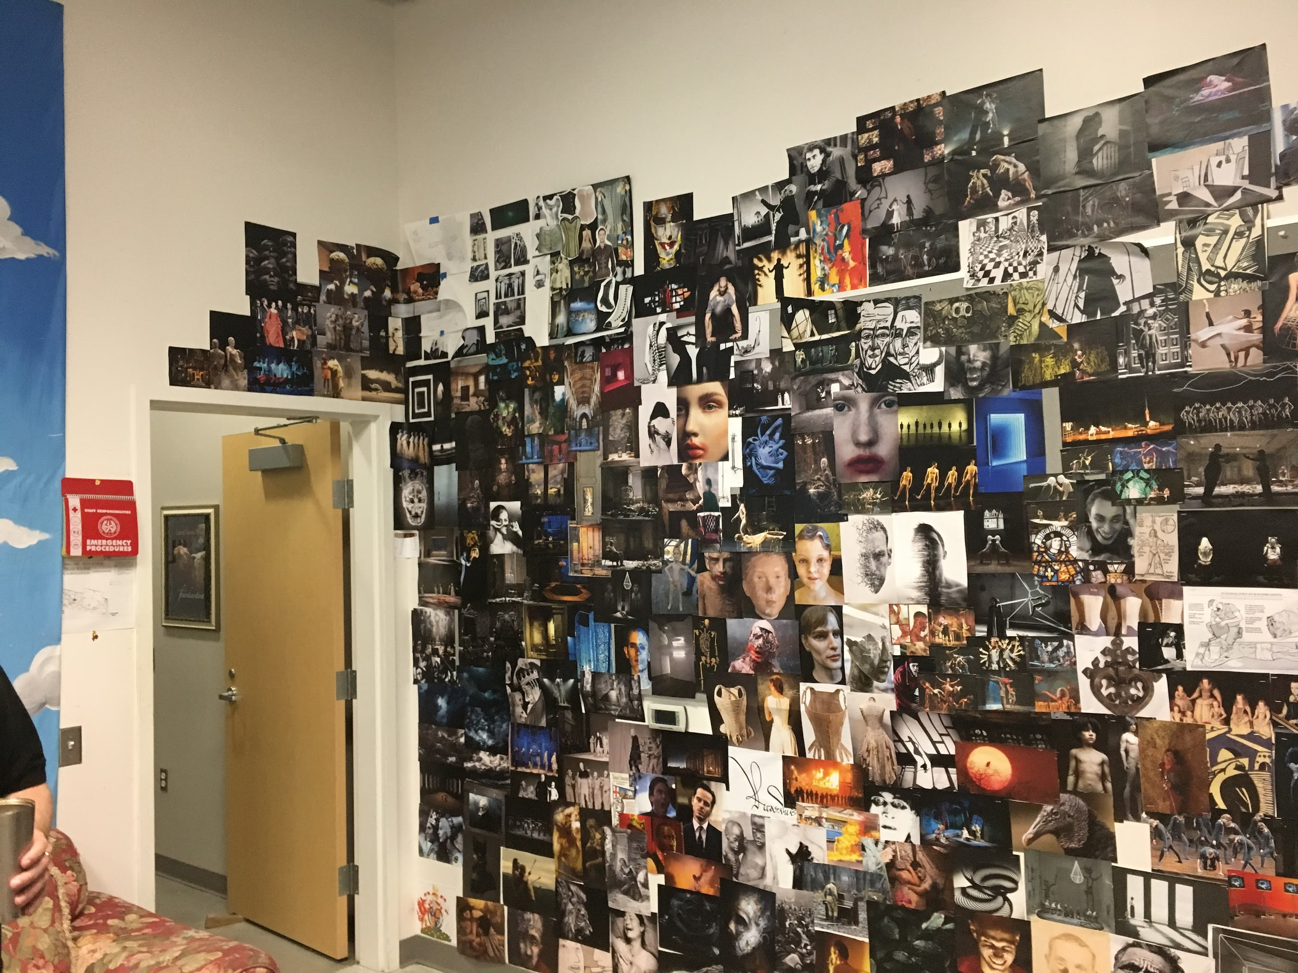
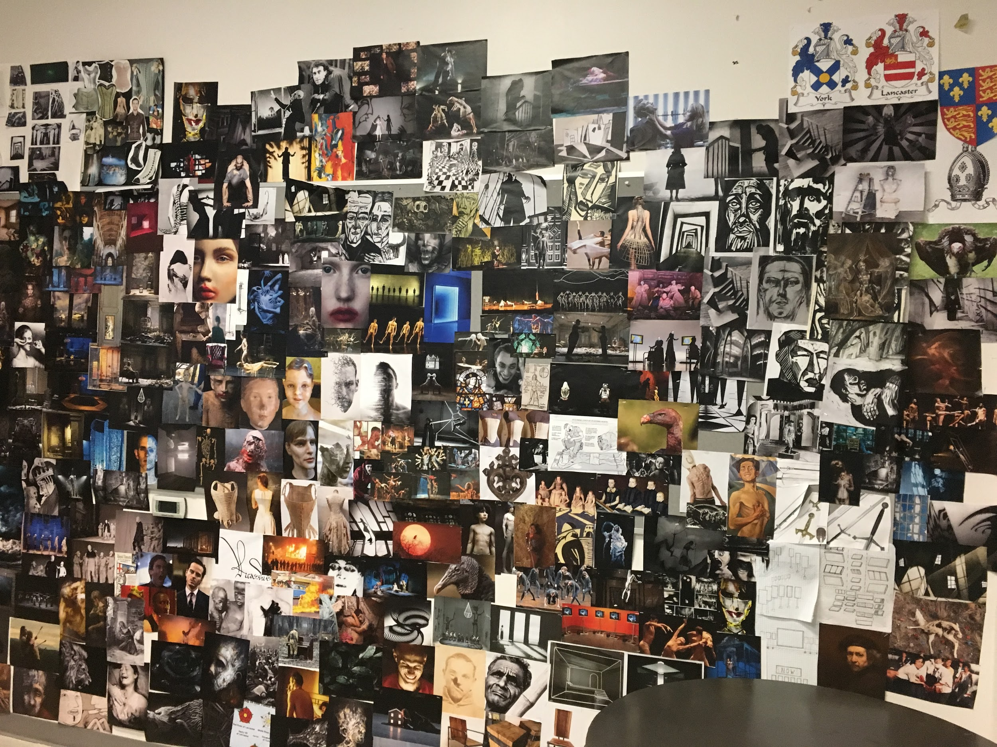
COMMUNICATE

Slide 10
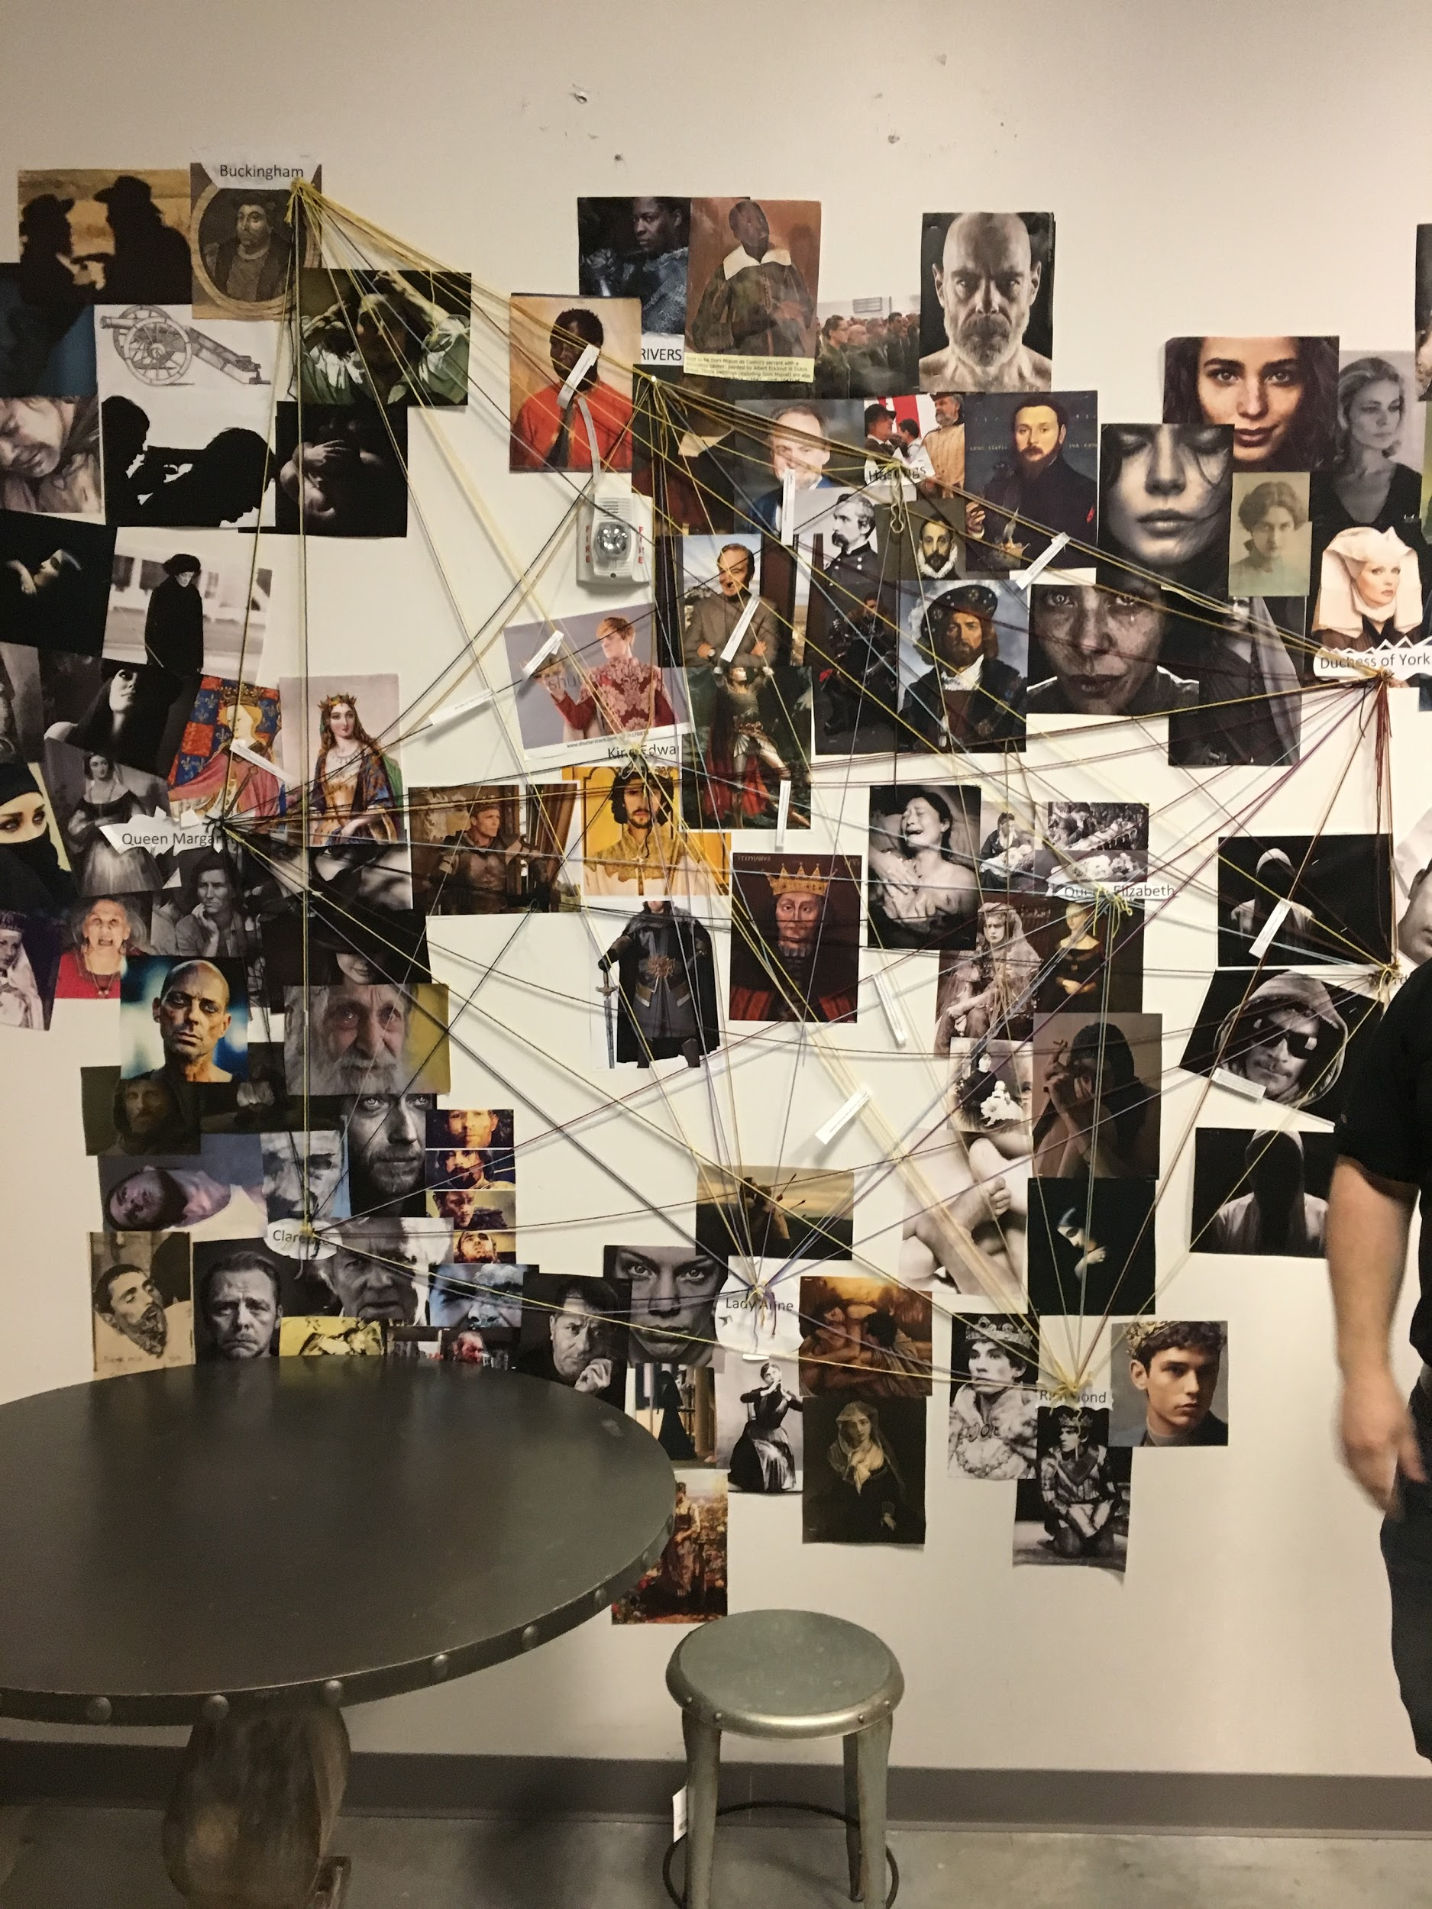
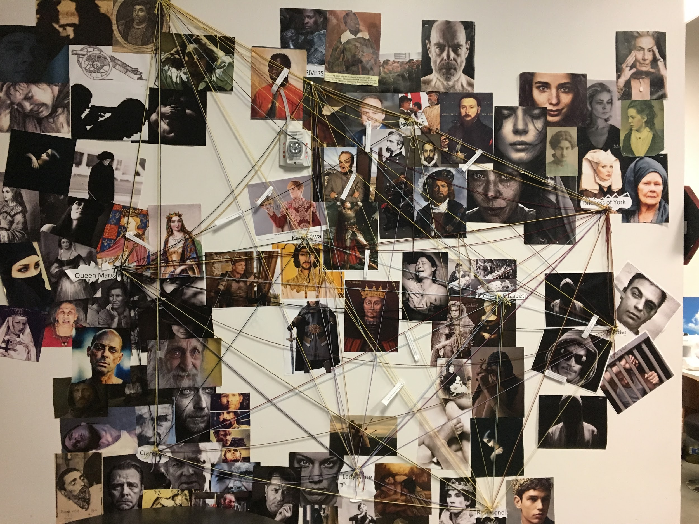
ACTOR’S WEB

Slide 11
PICTURES!!!!
www.carnegietheatre.com

